Slide 1
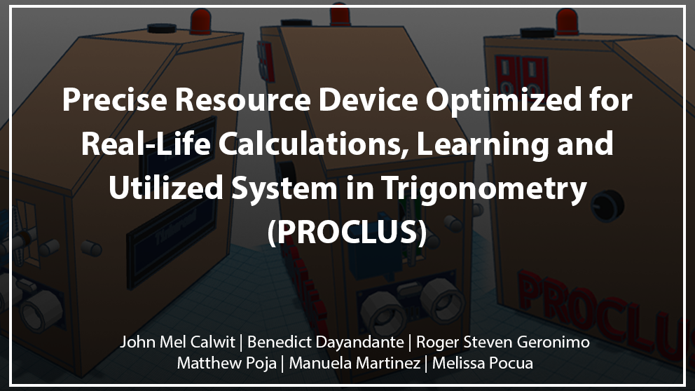

Slide 2
INTRODUCTION
Over time, extensive attempts have been undertaken to tackle the ongoing challenge. With the objective of enhancing comprehension, creative teaching methods and technological advancements have been employed. This paper shares the same goal by presenting a guide to simplify the complexities of Trigonometry using technology.
Another challenge is using trigonometric identities to resolve trigonometry problems. The multiple trigonometric identities and formulas necessary to solve problems may be difficult for students to recall and put into practice. Trigonometric issues' complexity could also present a challenge. Students often encounter challenges in solving trigonometry problems due to various factors such as insufficient understanding of trigonometry concepts, inability to apply the formulas correctly, and lack of practice. These challenges can lead to poor academic performance, frustration, and even discouragement among students.
Technology such as robotics can assist in solving trigonometric functions by providing precise and automated measurements. Robots equipped with sensors and mathematical algorithms can accurately determine angles and distances, enabling efficient calculations of sine, cosine, and tangent values.

Slide 3
OBJECTIVES
The objective of this study is to be able to create a mathematical device capable of guiding students in understanding Trigonometric identities and inverse trigonometric functions (STEM_PC11T-IIe-2). A device that is able to derive the corresponding sides of a triangle using the principles of trigonometry and angles, hence helping students learn and apply appropriate trigonometric identities in solving situational problems (STEM_PC11T-IIg-2).
This research aims to build a simple and portable mathematical device using an Arduino Uno microcontroller utilized trigonometry and other topics in geometry that will help students and teachers in:
a) solving the sides and the hypotenuse of a right triangle (Pythagorean theorem);
b) calculating the trigonometric ratios using the measurements measured by the device;
c) computing the angle of elevation and depression;
d) learning tool for trigonometry and geometry;
e) guiding for easy and scaled triangle drawing; and
f) converting the answers from degree to radian and vice versa

Slide 4
SCOPE AND LIMITATIONS
This device focuses on solving trigonometric problems that are incorporated in the real world. In other words, this device is mostly capable of solving trigonometry in real life applications. Our device also include the calculation for the sides and the hypotenuse of a right triangle (Pythagorean Theorem), degree and radian unit converter, finding the distance, height, angle, learning tool for trigonometry and geometry, and a guide for scaled 4 triangle drawing. It also aims to bridge the gap between theory and practical application, highlighting the relevance of trigonometry in real-world scenarios such as astronomy, construction, and aviation.
Even with technology on our side, the device is still only limited to a few things, such as being only focused on the device's functionality in solving trigonometric problems. It does not explore advanced mathematical concepts beyond trigonometry, and the device's functionality is limited to trigonometric calculations and visual display. Due to the large structure of the device, it cannot fit on small spaces. Our lack of knowledge in calibrating the sensors also affects the functionality of the device since it cannot measure large measurements and the fluctuation of values caused by the code in the system. This device is only restricted in solving right triangles since it has no capability in determining if the triangle is a right triangle or not .Lastly, the study does not delve into the technical specifications or programming details of the device, but rather focuses on its application and benefits in trigonometry education.

Slide 5
DEVICE FEATURES
Pythagorean Theorem Solver
This device uses robotics to measure and calculate for the basic sides of a triangle, ie. the side, base and the hypotenuse. Coded in it is the formula a2+b2=c2 (the pythagorean theorem). Using this, it can solve for the hypotenuse given the sides, and vice versa.
Trigonometric Ratios Calculator
PROCLUS can be used to solve for the basic trigonometric ratios such as the sine, cosine and tangent. It has the built-in function of measuring for the angle in either degree or in radian form, as well as the distance, using those inputs to solve for the corresponding trigonometric ratio.
Radian and Degree Unit Converter
As mentioned above, PROCLUS is capable of converting an angle into its radian form and vice versa. Coded into it is the formula θ*𝝅180 for converting degrees to radian, and x*180𝝅 for converting radian to degrees. This will allow users to easily know their corresponding value.

Slide 6
DEVICE FEATURES
Angle of Elevation and Depression Computer
Already mentioned are its functions to be able to measure for the distance. Its angles, using either degrees or its radian form. As well as its capability of performing trigonometric calculations. The aforementioned functions will allow PROCLUS to be able to measure either the angle of elevation, or the angle of depression, depending on what is needed.
Guide for Scaled Triangle Drawing
As this is a device that performs measurements and calculations in real time, it allows users to assimilate scaled drawings. PROCLUS can determine the needed measurements making it easy for students to draw it in scale.
Visual and Learning Tool for Trigonometry and Geometry
Geometry and trigonometry are some of the topics students find challenging. Hence why we invented PROCLUS. Given its precise calculations and measurements of the mentioned topics, as well as its ability to visualize it, learning will not only be easy, but also fun.

Slide 7
DEVICE FEATURES
Its functions can be associated with the name of the device
P - Pythagorean theorem solver
R - Radian and degree converter
O - Optimal angle of elevation and depression Solver
C - Calculator for trigonometric functions
L - Learning tool for trigonometry and geometry
U - Ultimate guide for scaled triangle drawing
S - Solving for the distance, height, and angle

Slide 8
SIGNIFICANCE OF THE DEVICE
This device will be beneficial to people who are getting involved in trigonometry and geometry, especially for the following;
Students - students, especially those who find it difficult to understand trigonometry would be the first to benefit from the device. Enabling them to easily visualize and solve for the answer.
Teachers - teachers who aim to easily teach trigonometric identities and solving situational problems involving it would also benefit greatly from the device. PROCLUS is a measuring device that solves for the distance of one point to the next using the principles of triangles and trigonometric identities. This in turn would easily allow them to demonstrate situational problems when teaching.

Slide 9
SIGNIFICANCE OF THE DEVICE
Engineering Fields and Professionals- with this simple device, professionals can maximize its features with on the go calculations and applications of trigonometry which is widely used in this field.
Future Researchers - future researchers can improve this study and can be a basis to develop an improved version of it that bridges the gaps and find an alternative solution to the limitations of the device
Community and Others - PROCLUS is a device intended not only on educational grounds. As it is first and foremost a measuring device, almost anyone can use it. Decorating the house, scaling a structure, as long as it 9 involves the principles of a triangle such as finding the height, the distance and the shortest possible path (hypotenuse) PROCLUS can be of use.

Slide 10
MATERIALS
Materials | Quantity | Cost per Quantity (Php) | Total Cost (Php)
Arduino Uno Microcontroller | 2 | 275.00 | 550.00
Ultrasonic Sensor | 1 | 75.00 | 75.00
SG90 Servo Motor | 1 | 90.00 | 90.00
Potentiometer | 1 | 25.00 | 25.00
60 nm Laser Diode | 3 | 89.00 | 267.00
16x2 LCD I2C | 1 | 100.00 | 100.00
20X4 LCD I2C | 1 | 199.00 | 199.00

Slide 11
MATERIALS
Leveling System
Accelerometer | 1 | 84.00 | 84.00
Piezo Electric Buzzer | 1 | 5.00 | 5.00
LED | 1 | 10.00 | 10.00

Slide 12
MATERIALS
Power Supply and Others
Jumper Wires | 37 | 5.00 | 185.00
9V Battery | 4 | 40.00 | 160.00
ON-OFF Way Switch | 2 | 15.00 | 30.00
9V Battery Holder | 2 | 25.00 | 75.00
Foam Board | 1 | 150.00 | 150.00
 |  | Total Amount | Php 2, 005

Slide 13
PROCEDURES
First get the measurements of the main components of the device, to maximize the portability of the structure.
Cut out the Styrofoam boards based off the acquired measurements and the practicality of the device
Make proper and fitted cutouts based on where you want the components (ie. LCD’s, Switch, Ultrasonic Sensor and Adjustment Knob), making sure placement efficiency is observed
Assemble the Styrofoam boards and the wirings of the main system circuit. Ensure that everything is fitted into place.
Design the device to your liking.

Slide 14
WORKING PRINCIPLES AND SYSTEM
Main System and Circuit
The main system is composed of an arduino microcontroller, servo motor, ultrasonic sensor, adjustment knob, and two LCDs. This system is powered with three 9 volt batteries and controlled with a two-way switch. The function of the main system is to calculate and display the answers solved by the device based on the concept solutions.

Slide 15
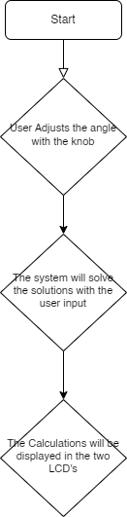
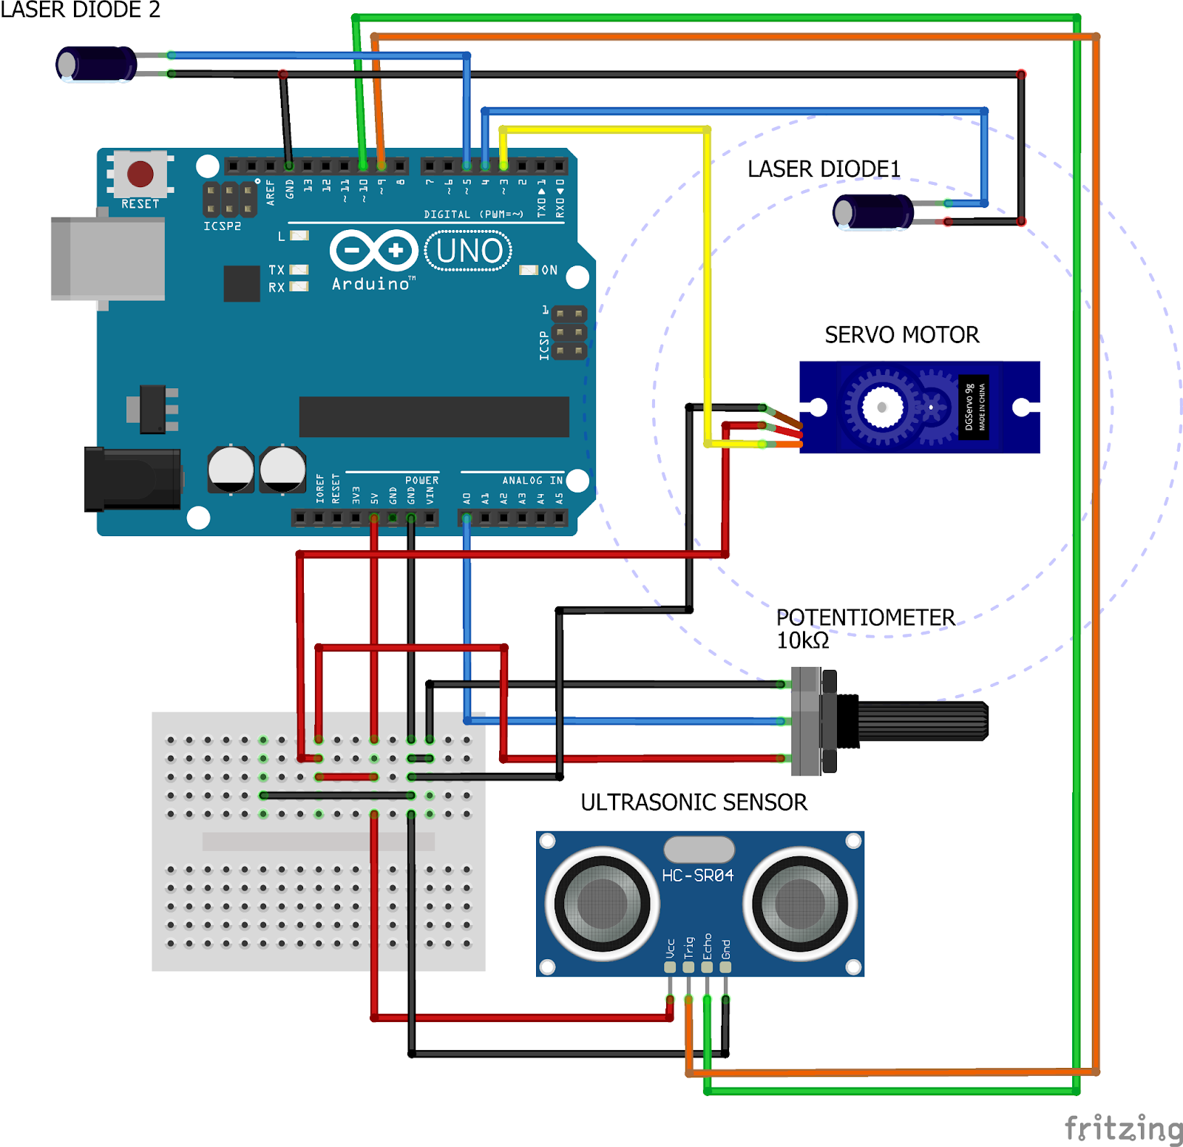
WORKING PRINCIPLES AND SYSTEM

Slide 16
WORKING PRINCIPLES AND SYSTEM
Leveling System and Circuit
The accelerometer is a sensor that will determine if the surface is even or not. If the surface is even, the LED will flash a steady red light and the buzzer will beep. This is both a visual and auditory tool that will guide the user in measuring. Though, even if the surface is uneven, solving it would still be possible because the device can measure tilted angles and the LED light will flash a blinking light to indicate that the surface is uneven.

Slide 17
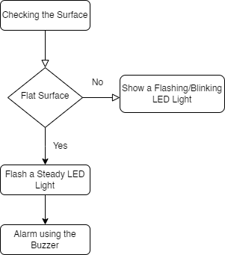
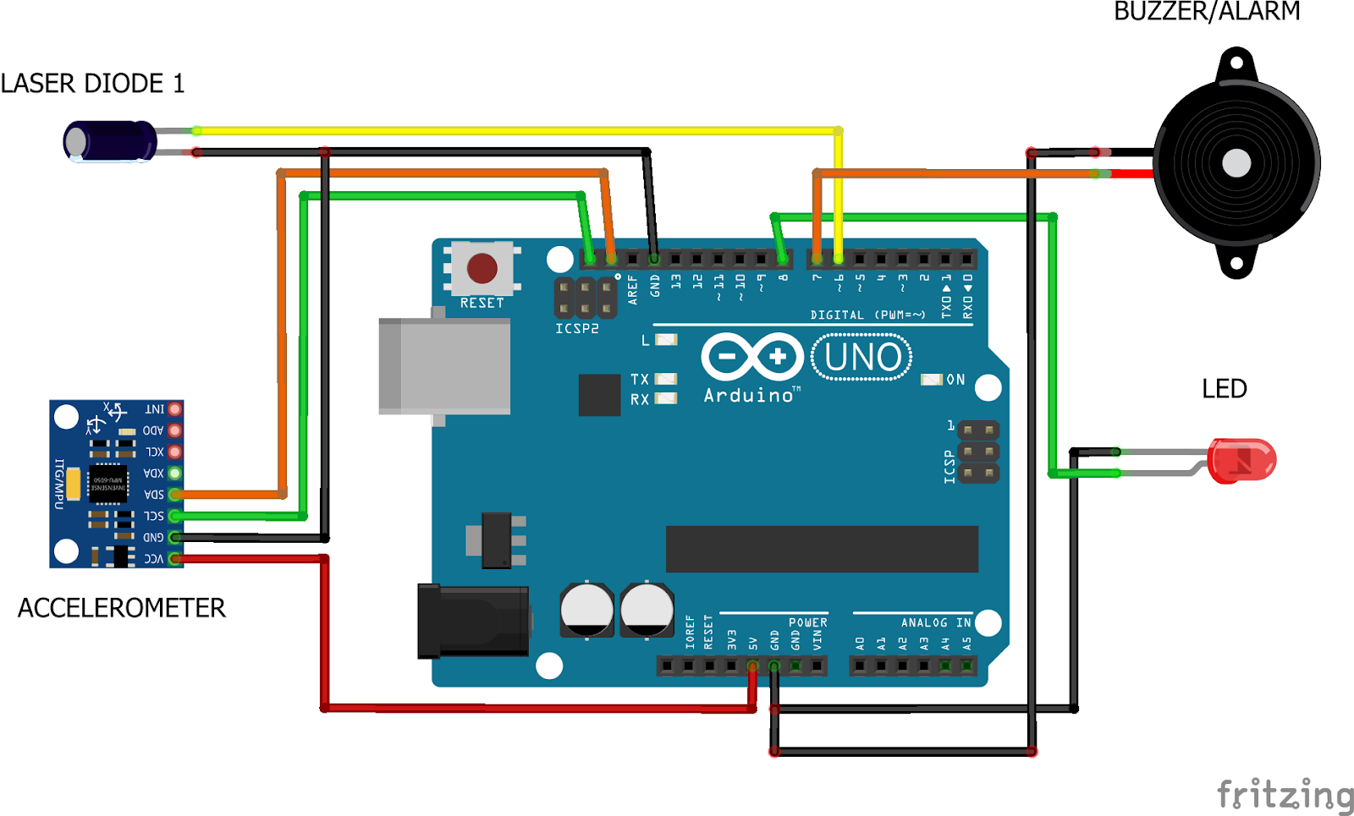
WORKING PRINCIPLES AND SYSTEM

Slide 18
WORKING PRINCIPLES AND SYSTEM
Calculation System
First and foremost, you need to define the six trigonometric functions: sine, cosine, tangent, cosecant, secant, and cotangent. Since the angle units used in the code to calculate is radian, we need to convert the angle entered by the user, solve it and convert it again in degrees.

Slide 19
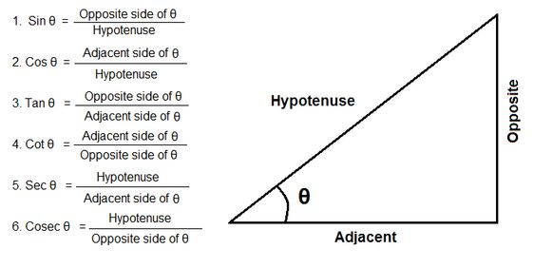
WORKING PRINCIPLES AND SYSTEM

Slide 20
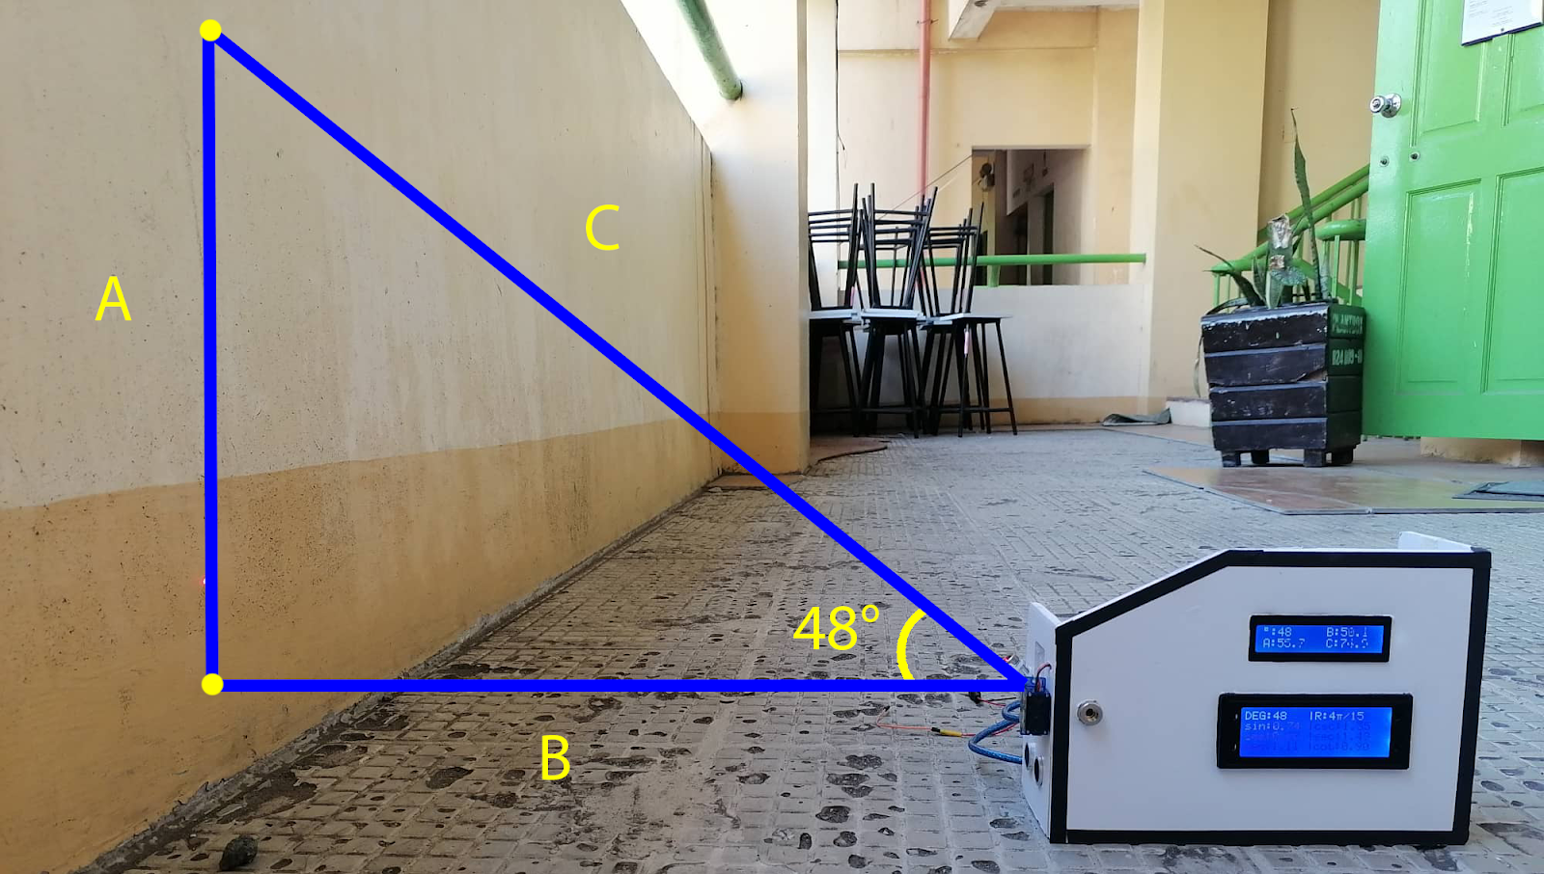
WORKING PRINCIPLES AND SYSTEM

Slide 21
WORKING PRINCIPLES AND SYSTEM
Display System
The Display system is the output of all the calculations made. Using two I2C Liquid Crystal Display (LCD) we can display all the solutions made by the device. We used 2 LCDs (1 large 20x4 and 1 small 16x2).

Slide 22
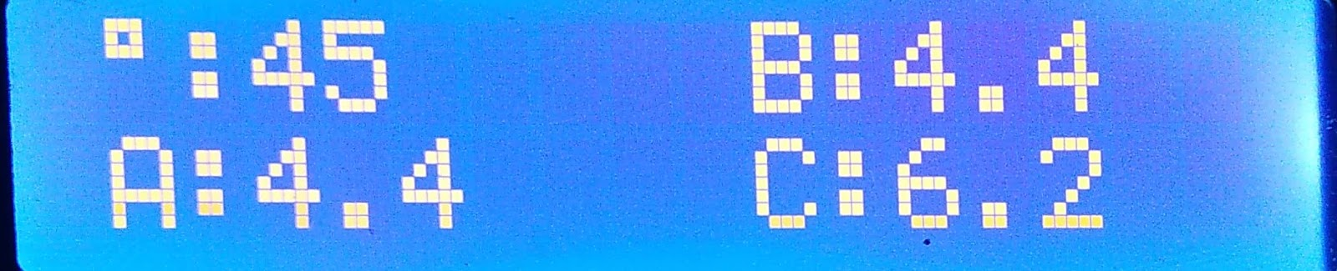
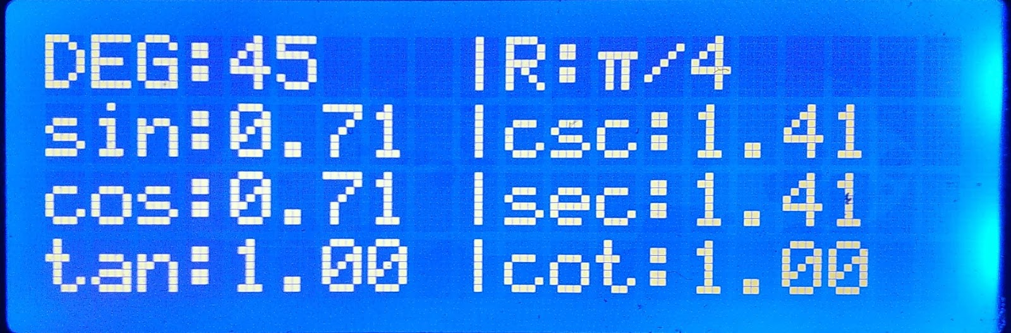
WORKING PRINCIPLES AND SYSTEM

Slide 23
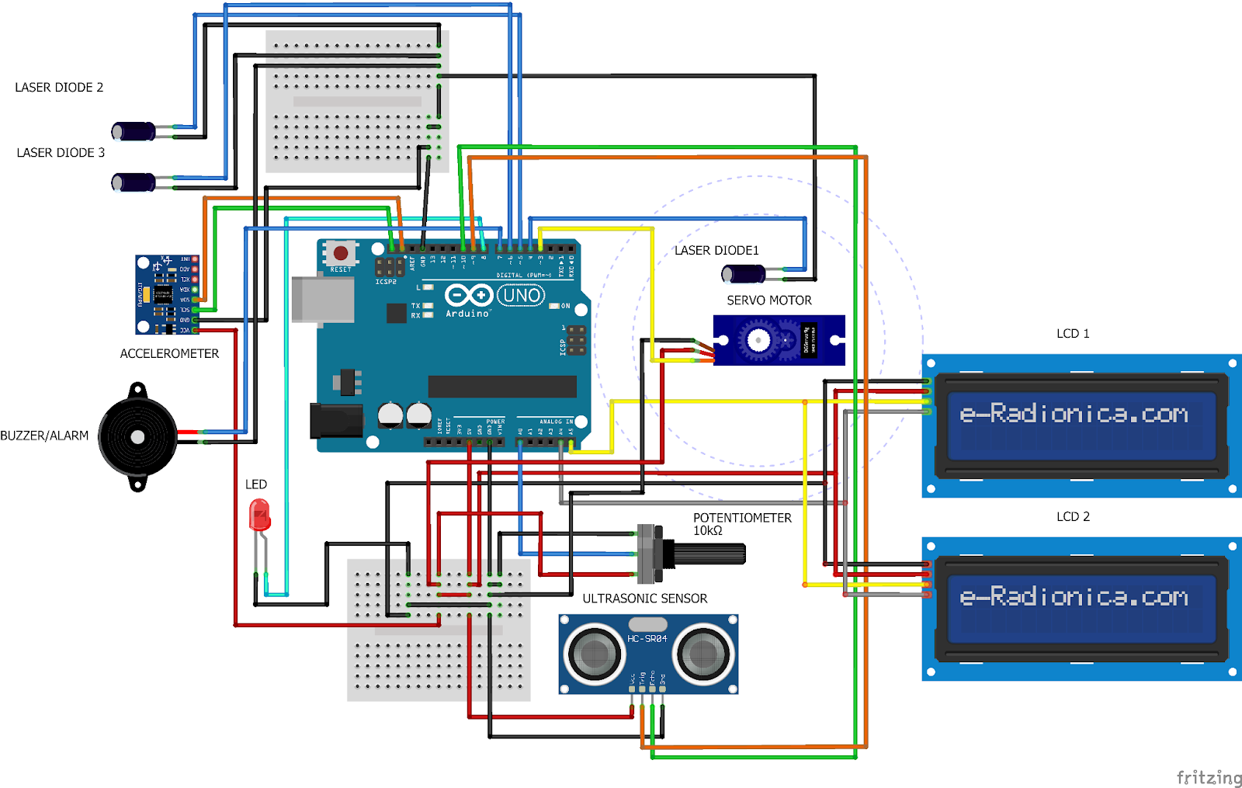
WORKING PRINCIPLES AND SYSTEM
Overall Circuit

Slide 24
UTILIZATION
Utilization of the Device
To use this device it is very simple and user friendly
Open the On off switch (The one that powers the main system). You can also turn on the Leveling System (also have a switch)
Using the Adjustment knob, you can adjust the angle input from 0-180 degrees. We divided it into two 90 degree angles (positive for the angle of elevation or angle greater than 90 degrees, negative for the angle of depression or angle that is and 0 if the angle is 90 degree).

Slide 25
UTILIZATION
3. The angle, opposite side, adjacent side and the hypotenuse is displayed in real time in the small lcd.
4. The Automatic Leveling System doesn’t require any input from the user. The system will flash a blinking LED light if the surface is uneven and if the surface is flat and ready for computing, the system will alarm or beep and the LED light will light steadily. This system can be turned on or off when the user wants to compute tilted angles and complicated measurements.

Slide 26
UTILIZATION
5. There are 3 lasers that will visually guide you on the angle or triangle that will be formed with the exact measurements.
6. That’s how easy it is for you to use this device. If you want to compute for another measurement, just repeat the process of using the knob and pushing the solve button.

Slide 27
UTILIZATION
5. There are 3 lasers that will visually guide you on the angle or triangle that will be formed with the exact measurements.
6. That’s how easy it is for you to use this device. If you want to compute for another measurement, just repeat the process of using the knob and pushing the solve button.

Slide 28
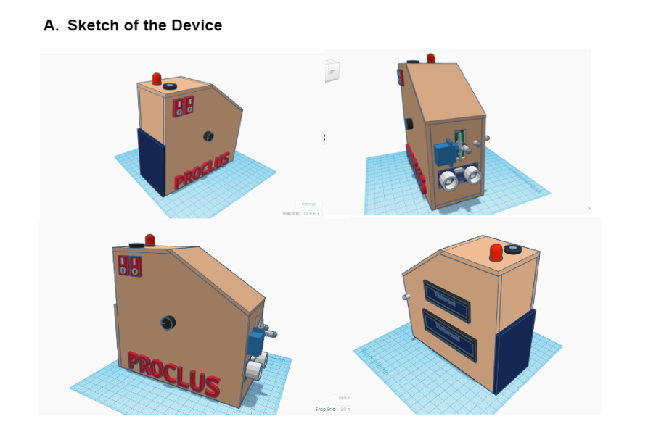
DEVICE MODEL

Slide 29
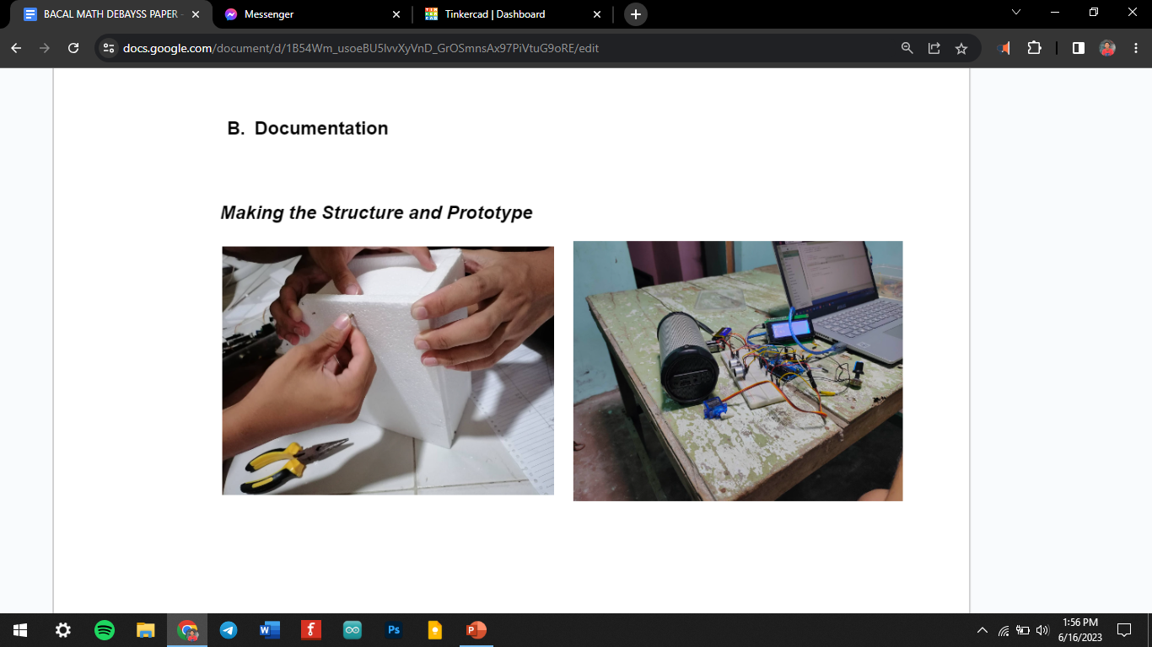
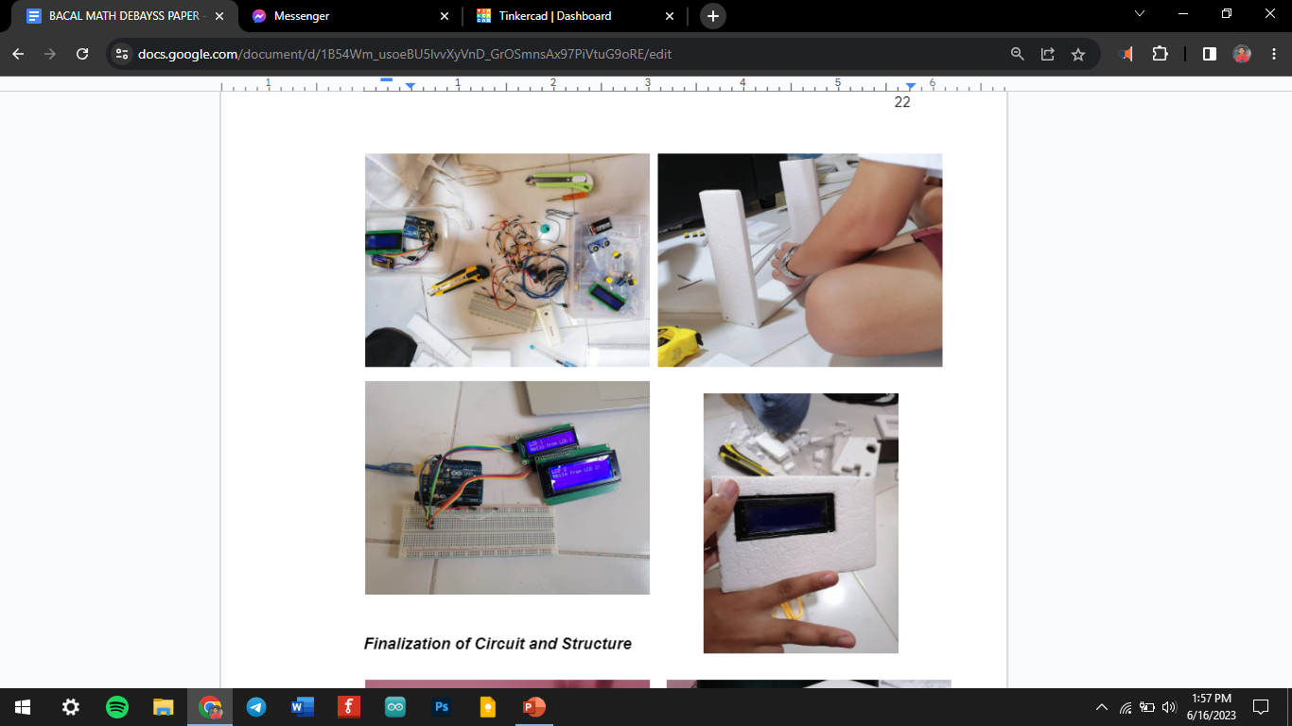
DOCUMENTATION

Slide 30
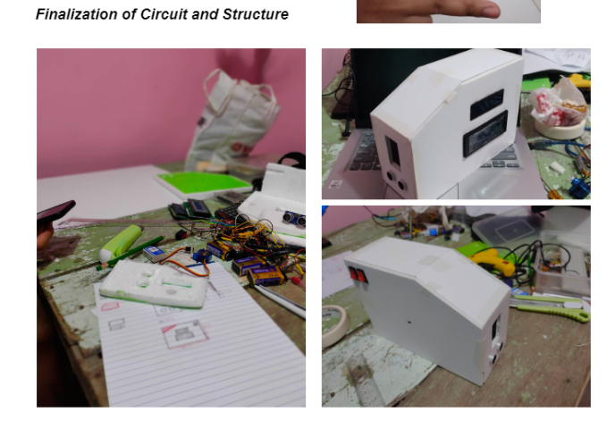
DOCUMENTATION

Slide 31
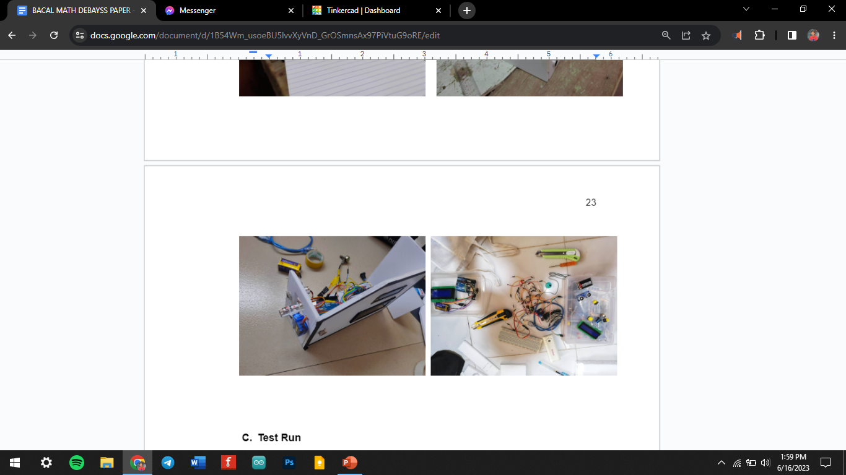
DOCUMENTATION

Slide 32
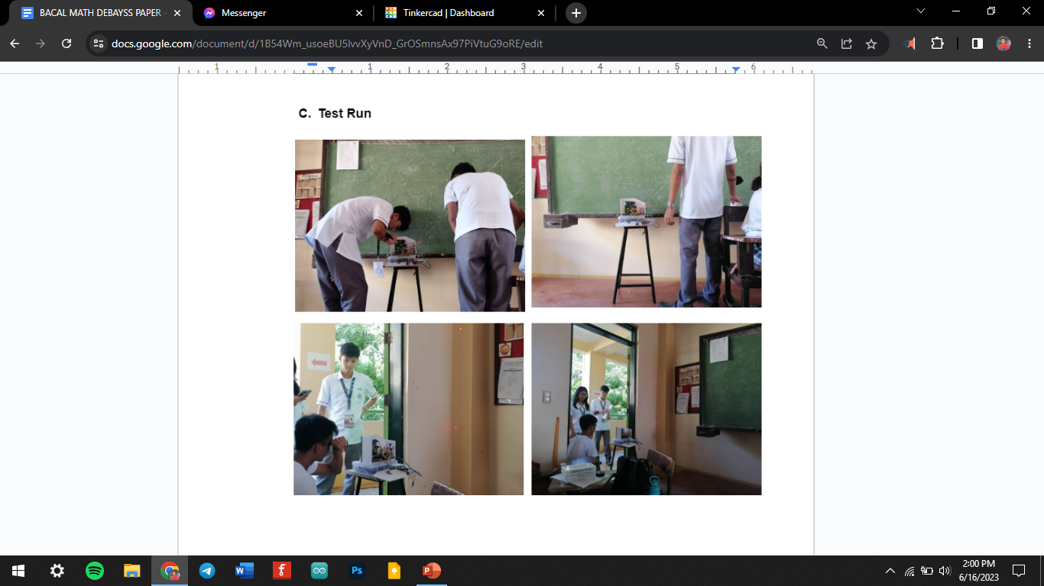
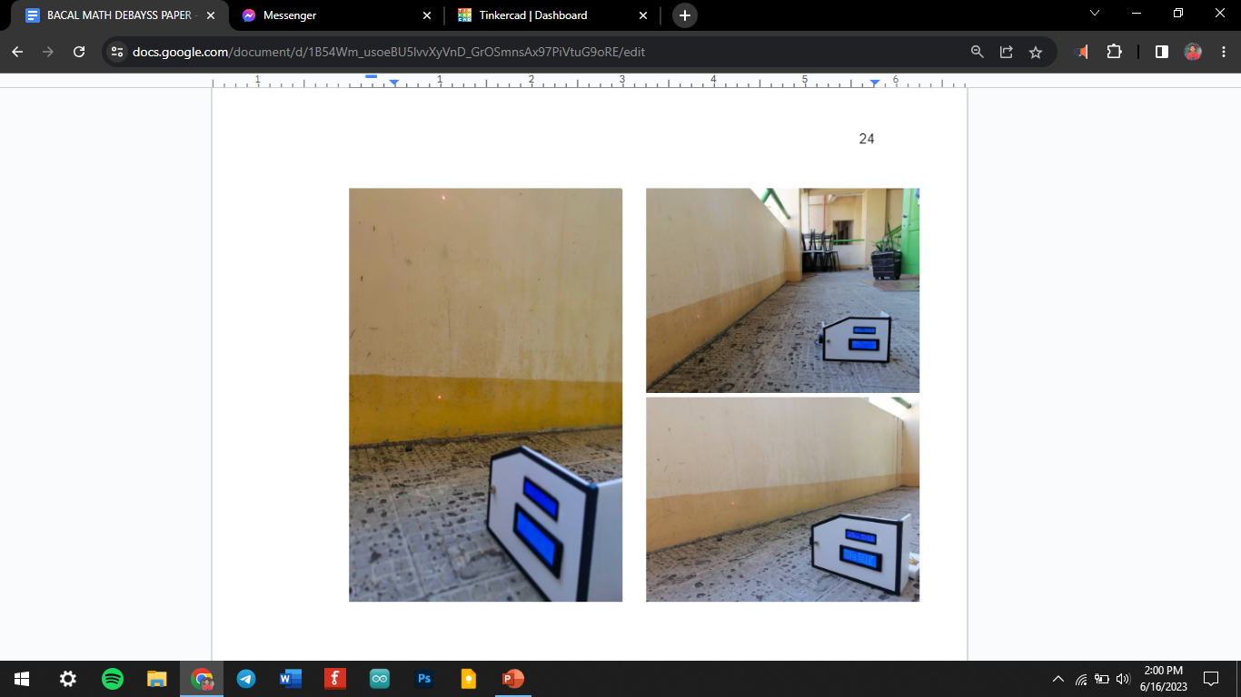
TEST RUN

Slide 33
TEST RUN
Since the device is composed of various systems, it needs to be tested before implementing it. We did a total of five tests, one for each system of the device to ensure that we will fulfill the objectives and the functionality of the device that we’ve built.
The main components and functionality of the device depends on the main system which all of its functions are included here. The adjustment knob was working properly after we soldered it with a solid wire. The servo motor is one of the biggest problems that took up so much time for us to fix since it is difficult to determine what is the root cause of the problem. The ultrasonic sensor which is capable of measuring the distance from one place to another had some discrepancy on the measurements that barely affects the calculated measurements. But after the test runs and prototyping, we manage to resolve these problems on the device.

Slide 34
TEST RUN
For the calculation system, the calculations were accurately displayed in the display system. The code and the formula we used were the same when we tested it and we solved it manually on our own. The code works best in solving since computers have a less chance of making mistakes in calculations. However, the sensors do affect the readings of the data that will be used in the calculation. As we mentioned earlier, we don’t have that much experience in calibrating sensors but based on the results, it has some little discrepancy on the measurements.
The display system is one of the trickiest parts that we’ve experienced. Since we have to display the six trigonometric ratios and the degree and radian unit in addition to it in one LCD, we need to find a way to fit it there. Furthermore, the display system works as it is intended to be with some error that we’ve fixed caused by the power supply.

Slide 35
TEST RUN
For the laser and scaled drawing system, the laser is working perfectly fine after some tests because at first, we are having some difficulty on placing the laser on the correct placement since it has to complement with the moving laser attached to the servo motor to perfectly guide the user. We did some testing and calibration of the whole drawing and laser system and turns out we managed to draw a scaled right triangle with the measurement that we want it to be.
An additional feature of our device is the leveling system which will guide the user to know if the surface is flat or not. It can also determine the placement of the device if it is perfectly leveled even if you are just holding it and not placed on a surface. We have no problems with the LED and Buzzer for the visual and auditory tool but the accelerometer sensor which was responsible for determining the axis was very difficult to utilize since we are not familiar with that sensor. We did some test runs and did our best to calibrate it until it works perfectly together with the LED and Buzzer.

Slide 36
TEST RUN
In conclusion, testing this device is a long process and a lot of patience is required in order to achieve the desired results. We cannot just build it and sacrifice the accuracy of the device but we need to undergo many tests to ensure its functionality. What we’ve realized in making this device is that exploring isn’t just going to lead you to discovery but the process while exploring will shape your character and help you learn step by step. Realizing the problems, applying what you already know, and gaining new knowledge that you can use to explore many things. PROCLUS isn’t just a device for calculation itself but a device that teaches us how to cope up with life’s real world problems and challenges.

Slide 37






ABOUT THE PROPONENTS
ABOUT THE PROPONENTS
thanks puuu!
antok na akooo😴
bye punta na akong canada…
“lang uyammmm”
“asan na yung 200 ko😭“
backpain malala
pagod na sa layf, miss na si ano

